Slide 1
Chapter 2: Working with JSPs

Slide 2
Learning Objectives
JSP Standard Actions (useBean tag, setProperty tag , getProperty tag, include tag, forward tag, param tag, plug-in tag , params tag , fallback tag, directives tag , scriptlet tag, expression tag)
JSP Custom Actions (classic tags, simple tags)
JSP Scopes Introduction
Request Scope
Application Scope
Session Scope
Page Scope
JSP implicit objects

Slide 3
JSP Standard Actions
Actions use constructs in XML syntax to control the behavior of the servlet engine. You can dynamically insert a file, reuse JavaBeans components, forward the user to another page, or generate HTML for the Java plugin.
There is only one syntax for the Action element, as it conforms to the XML standard:
<jsp:action_name attribute = "value" />
Action elements are basically predefined functions.
There are two attributes that are common to all Action elements: the id attribute and the scope attribute.
The id attribute uniquely identifies the Action element, and allows the action to be referenced inside the JSP page. If the Action creates an instance of an object, the id value can be used to reference it through the implicit object PageContext (more on this later).
This attribute identifies the lifecycle of the Action element. The id attribute and the scope attribute are directly related, as the scope attribute determines the lifespan of the object associated with the id. The scope attribute has four possible values:
page
request
session
application.

Slide 4
JSP Standard Actions
Action | Description
jsp:include | Includes a file at the time the page is requested.
jsp:useBean | Finds or instantiates a JavaBean.
jsp:setProperty | Sets the property of a JavaBean.
jsp:getProperty | Inserts the property of a JavaBean into the output.
jsp:forward | Forwards the requester to a new page.
jsp:plugin | Generates browser-specific code that makes an OBJECT or EMBED tag for the Java plugin.
jsp:element | Defines XML elements dynamically.
jsp:attribute | Defines dynamically-defined XML element's attribute.
jsp:body | Defines dynamically-defined XML element's body.
jsp:text | Used to write template text in JSP pages and documents.

Slide 5
JSP Custom Tags
A custom tag is a user-defined JSP language element. When a JSP page containing a custom tag is translated into a servlet, the tag is converted to operations on an object called a tag handler.
The Web container then invokes those operations when the JSP page's servlet is executed.
JSP tag extensions lets you create new tags that you can insert directly into a JavaServer Page.
The JSP 2.0 specification introduced the Simple Tag Handlers for writing these custom tags.
To write a custom tag, you can simply extend SimpleTagSupport class and override the doTag() method, where you can place your code to generate content for the tag.
You can include a message in the body of the tag as you have seen with standard tags.
You can use various attributes along with your custom tags. To accept an attribute value, a custom tag class needs to implement the setter methods, identical to the JavaBean setter methods.

Slide 6
Custom Tags in JSP…
Custom Tags in JSP are user defined tags and are used to separate business logic from JSP pages and eliminate scriptlet tag. By using these custom tags one can use same business logic many times.
JSP page will be translated into servlet if it has custom tags, the tag handler is an instance used to translate user defined tags to operations. After the execution of JSP servlet page operations will be invoked by the web container.
The following are the advantages of custom tags:
By using the custom tag, avoiding scriptlet tag.
Custom tag has the ability to partitioning the JSP business logic then code can be maintained easily.
By using the custom tag, reuse the same business logic.

Slide 7
Custom Tags in JSP: Inheritance Heirarchy

Slide 8
JSP Custom Actions: Attributes
You can define the following properties for an attribute in TLD file:
Property | Description
name | The name element defines the name of an attribute. Each attribute name must be unique for a particular tag.
required | This specifies if this attribute is required or is an optional one. It would be false for optional.
rtexprvalue | Declares if a runtime expression value for a tag attribute is valid
type | Defines the Java class-type of this attribute. By default it is assumed as String
description | Informational description can be provided.
fragment | Declares if this attribute value should be treated as a JspFragment.

Slide 9
Custom Tags in JSP - Example

Slide 10
Scopes in JSPs
The scope of a parameter/attribute denotes the availability of that parameter/attribute for use. A web application serves multiple requests from clients when it is up and running. These requests can be from same client or different clients. We have seen from the servlet life cycle that a servlet’s service() method is called every time a request comes.
Scopes in a JSP application are:
Request Scope: A JSP object created using the ‘request’ scope can be accessed from any pages that serves that request. More than one page can serve a single request. The JSP object will be bound to the request object. Implicit object request has the ‘request’ scope.
Page Scope: ‘page’ scope means, the JSP object can be accessed only from within the same page where it was created. The default scope for JSP objects created using <jsp:useBean> tag is page. JSP implicit objects out, exception, response, pageContext, config and page have ‘page’ scope.
Session Scope: ‘session’ scope means, the JSP object is accessible from pages that belong to the same session from where it was created. The JSP object that is created using the session scope is bound to the session object. Implicit object session has the ‘session’ scope.
Application Scope: A JSP object created using the ‘application’ scope can be accessed from any pages across the application. The JSP object is bound to the application object. Implicit object application has the ‘application’ scope.

Slide 11
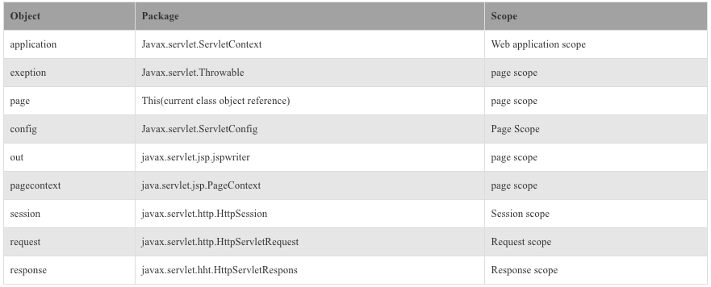
JSP Implicit Objects
JSP Implicit Objects, JSP has 9 implicit objects made by web container and those implicit objects are available in all JSP pages. Implicit objects can be directly used in scriptlets. JSP Implicit objects can be directly used without declaring.
Following Implicit Objects are available on a JSP page:
Out
Page
Page Context
Exception
Config
Application
Session
Request
Response

Slide 12
JSP Implicit Objects
Page: Page is an implict object. Page object is used for referencing auto generated Servlet class. For using page object type casting must be done.
Out: Out object is used for writing data into buffer. Out object belongs to JspWriter. Out object is mostly used with JspExpression to invoke the class.
Request: Request is an implict object of HttpServletRequest. Request object is used for requesting parameters, character encoding, header type, content, information, remote address, server name, server port.
Exception: Exception object is typically utilized for producing a suitable reaction to the mistake condition.

Slide 13
JSP Implicit Objects…
Page Content: The pageContext is utilized to indicate the whole JSP page. PageContext object is an instance of a javax.servlet.jsp.PageContext.PageContent object is used as a way to get to data about the page while concealing a large portion of the execution points of interest.
Config: This object is utilized to get introduction parameter for a specific JSP page and it is made to every single JSP page.
Response: Response object is used for providing methods to the HTML header. Responce object is implict of javax.servlet.http.HttpServletRequest.
Session: Session object is associated with HTTP Request. Session object is for set, get or remove attribute or to get session information.
Application: It is an instance of a javax.servlet.ServletContext. Application object is created by web container. Application object is also used to get RequestDispatcher object.

Slide 14
What are we learning in Next Chapter ?
You will learn about Advanced JSP Techniques
We will learn about:
Design Patterns and Architecture styles with JSP
Model View Controller (MVC ) Architecture
Model 1/Model 2 Architecture
JSP Expression Language (EL)
JSTL & Tag Library
Custom tags in practice

Slide 15
Thank You !

